Slide 1
Chapter 7: Segmentation, Target Marketing, And Positioning
Part 2: Use Information to Drive Marketing Decisions
McGraw-Hill
Education

Slide 2
Learning Objectives
Explain the criteria for effective segmentation.
Identify the various approaches to market segmentation.
Describe the steps in target marketing.
Define positioning and link it to the use of the marketing mix.
Use and interpret perceptual maps.
Identify sources of differentiation.
Avoid potential positioning errors.

Slide 3
Fulfilling Consumer Needs and Wants
Market segmentation
Target marketing
Positioning

Slide 4
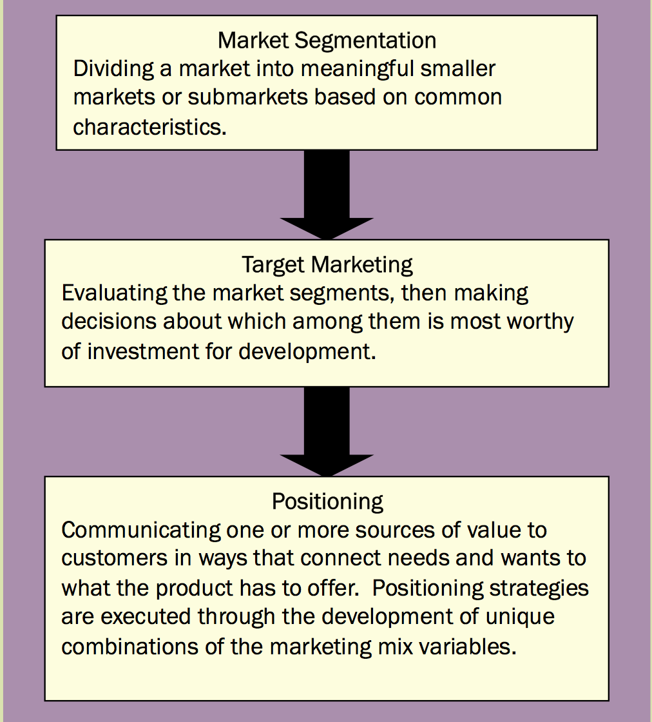
Market Segmentation, Target Marketing, and Positioning
EXHIBIT 7.1
Link to long alt text description

Slide 5
What Is Segmentation?
Segmentation seeks to find one or more factors about members of a heterogeneous market that allow for dividing of the market into smaller, more homogeneous subgroups.
The purpose is to develop different marketing strategies to best meet the segments’ distinct needs and wants.

Slide 6
What Is Segmentation?
Not all customers are alike.
Subgroups of customers can be identified on some basis of similarity.
The subgroups will be smaller and more homogeneous than the overall market.
Needs and wants of a subgroup are more efficiently and effectively addressed than would be possible within the heterogeneous full market.

Slide 7
Criteria for Effective Segmentation
Is the segment of sufficient size?
Is the segment readily identifiable and can it be measured?
Is the segment clearly differentiated on one or more important dimensions?
Can the segment be reached in order to deliver the value of the product?
Notes:
Is the segment of sufficient size to warrant investing in a unique value- creating strategy for that segment as a target market? Ultimately, there is no point doing market segmentation unless a positive return on investment is expected. Size of a segment doesn’t necessarily mean number of customers—when Bombardier markets its small Learjets, it knows the number of potential buyers is limited.
Yet, segmentation is still a valid approach because of differences in needs and wants among customers and the financial size of the transaction.
Is the segment readily identifiable and can it be measured? Effective segmentation relies on the marketing manager’s ability to isolate members of a submarket to create a unique appeal. Segmentation most often requires data and if secondary data on the markets of interest aren’t available or if primary data can’t be easily collected, it may not be possible to do
Is the segment clearly differentiated on one or more important dimensions when communicating the value of the product? For segmentation to work properly, it must allow for the creation and execution of different marketing strategies to the different submarkets identified. Segments should be expected to respond differently to different marketing strategies and programs. Otherwise, there is no reason to differentiate.
Can the segment be reached (in terms of both communication and physical product) in order to deliver the value of the product, and subsequently can it be effectively and efficiently managed? Barriers to reaching a segment might include language, physical distance, or, as in the case of some developing markets, transportation, technology, and infrastructure challenges. Firms have to be able to sustain their management of a target segment over time—if this activity becomes problematic, it can be a drain on resources and result in poor ROI.

Slide 8
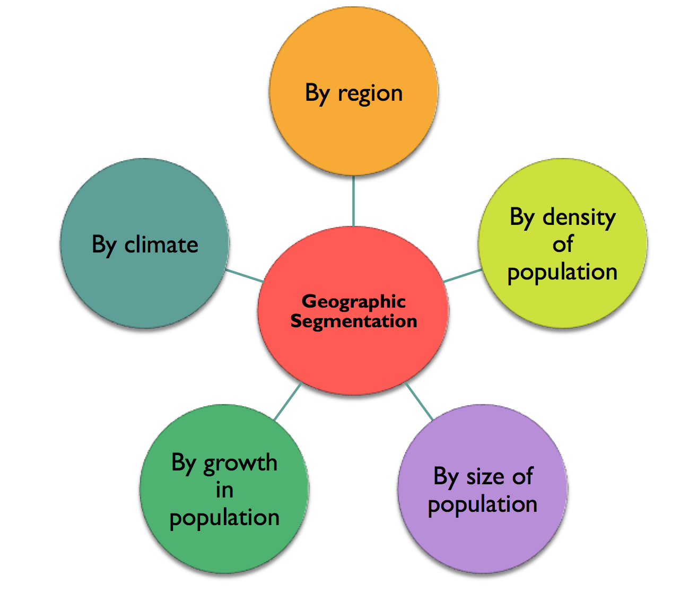
Geographic Segmentation
Link to long alt text description
Notes:
By region—Northeast, Southeast, Midwest, and West, for example.
By density of population—urban, suburban, exurban, and rural, for example.
By size of population—Exhibit 6.4 shows the top 20 standard metropolitan statistical areas (SMSAs) in the United States.
By growth in population—Exhibit 6.5 highlights the top 10 fastest-growing markets from 2010 to 2011, by number of people and percentage growth.
By climate—colder Northern states versus warmer Southern states.

Slide 9
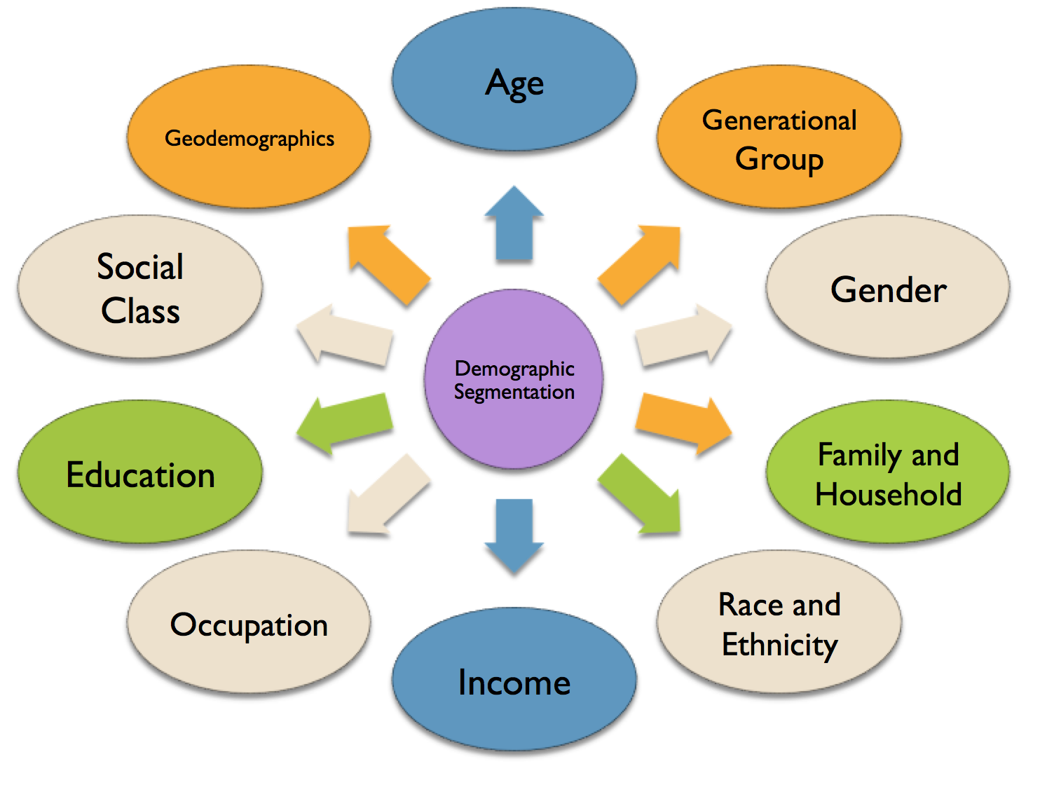
Demographic Segmentation
Link to long alt text description

Slide 10
Geo-demographics
Hybrid of geographic and demographic.
PRIZM-NE database profiles every zip code in the U.S. by demographic and psychographic methods.
Winner’s Circle
Wealthy suburban lifestyle
35-54-years-old
Married/couples
Large families
$100,000 median income
Area with parks, golf courses
Near upscale malls
They travel, shop, ski, eat out

Slide 11
Psychographic Segmentation
Personality, lifestyle, and values.
AIO: Attitudes, interests, and opinions
VALS data based on level of resources and primary motivation.
Notes:
VALS : The key drivers in the system are the person’s level of resources (high/low), innovation (high/low), and primary motivation (ideals, achievement, and self-expression). According to SBI, “Each of us is an individual. Yet each of us also has personality traits, attitudes, or needs that are similar to those of other people. VALS™ measures the underlying psychological motivations and resources that groups of consumers share that predict each group’s typical choices as consumers.”

Slide 12
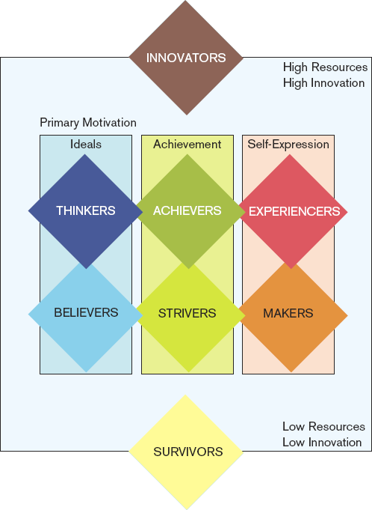
VALS™ Framework
EXHIBIT 7.9
Link to long alt text description
Reprinted with permission from VALSTM Program, SRI Consulting Business Intelligence (SRIC-BI); www.sric-bi.com/VALS.
9-12

Slide 13
Behavioral Segmentation
Benefits Sought looks to identify the crucial value-adding properties of an offering.
Key starting place for segmentation
Usage Patterns:
Light, medium, or heavy users
80/20 rule
Loyalty programs build on satisfying heaviest users.
9-13
Notes:
Benefits Sought Why do people buy? That is, what are the crucial value-adding properties of an offering? For many people, a Walmart Supercenter offers the ultimate in one-stop shopping. The idea of going to one store and getting every- thing from groceries to CDs to kitty litter has a lot of appeal, if the critical benefit sought is broad selection, low prices, and infrequent, extended trips to the store. On the other hand, in recent years Walgreens drugstores have been cropping up on corner after corner of high-traffic streets. Walgreens has been extremely successful in appealing to a shopper seeking a different set of benefits, namely less time in the store and a lower level of hassle. The chain caters to consumers for whom the convenience of having a store that is close to home or en route to work trumps other potential benefits such as selection and price.
Usage Patterns Segmentation by usage patterns includes usage occasions, usage rate, and user status. Occasions means specifically when the product is used. Why do you buy greeting cards? What causes you to take your significant other out for that special dinner? What makes you break down and rent that tux or buy that formal? Each of these purchases is driven by an occasion, and marketers are very savvy at playing to consumers’ desires to use occasions as a reason to buy.

Slide 14
Segmenting Consumer Markets
Firms use multiple segmentation approaches simultaneously.
Firms develop a profile of a segment that might include aspects of any or all of the segmentation approaches.
9-14

Slide 15
Steps in Target Marketing
Analyze market segments.
Develop profiles of each potential target market.
Select a target marketing approach.

Slide 16
Segmenting Business Markets 1
Demographic
Industry
Company size
Location
Operating Variables
Technology
User Status
Customer capabilities
Purchasing Approaches
Purchasing Function organization
Power Structure
Nature of existing relationships
General purchasing policies
Purchasing criteria
9-16

Slide 17
Segmenting Business Markets 2
Situational Factors
Urgency
Specific application
Size of order
Personal characteristics
Buyer-seller similarity
Attitudes towards risk
Loyalty

Slide 18
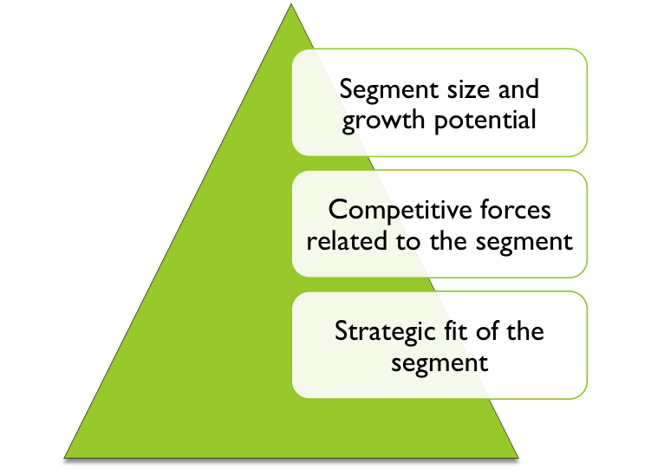
Target Marketing: Market Segment Analysis
Analyze market segments
Link to long alt text description
Notes:
A number of strategic factors come into play when analyzing whether a segment is a good candidate for investment as a target market. Many different factors should be considered in the analysis. The goal is to determine the relative attractiveness of the various segments using an ROI (return on investment) approach. Everything else being equal, it is prudent to assign a high level of attractiveness to segments that provide the quickest, highest-level, and longest-sustaining anticipated ROI. Several factors should be considered when analyzing segment attractiveness. The following are among the most important: segment size and growth potential, competitive forces related to the segment, and overall strategic fit of the segment to the company’s goals and value-adding capabilities.
Segment Size and Growth Potential Reckitt Benckiser is a British consumer goods company known for brands such as Dettol and (the best-selling antiseptic in the world), Veet (the best-selling depilatory brand globally), and smaller brands such as Clearasil, Lysol. Its biggest brands, however, are less well-known in the United States, so to move into U.S. markets, where it was not well represented, the company acquired Mucinex, Delsym, and eventually Cepacol, which positioned it squarely in the cough-and-cold market.
Competitive Forces Related to the Segment In chapter 3 identified Michael Porter’s competitive forces that firms must be cognizant of when considering investment in new target markets. For Reckitt Benckiser’s cough-and-cold business, several of these forces predominate. First, rivalry among existing firms is fierce. Reckitt Benckiser entered a market dominated by Johnson & Johnson, but with fierce competition from brands like P&G as well. Second, a strong threat of substitute products is present in the form of a variety of cough-and-cold remedies, from homeopathic treatments to prescription medication to less conventional treatments like nasal irrigation (through neti pots and other sinus washes). New entrants are less of a threat, as patents and R&D make the barriers to entry high, and suppliers are not highly concentrated.
Strategic Fit of the Segment Strategic fit means there is a good match of a target market to the firm’s internal structure, culture, goals, and resource capabilities. In the case of the Reckitt Benckiser acquisition of Mucinex and Delsym, the advantages and strategic fit were clear. The company already possessed similar international brands, and so it had experience with sourcing, production, and marketing. The brands also fit in well with the existing cleaning and disinfectant lines owned by Reckitt Benckiser, such as Lysol, since purchases of disinfectants often go hand-in-hand with purchases of cough or cold medication. The nature of the acquired brands was a great strategic fit for much of what Reckitt Benckiser already does in the market.

Slide 19
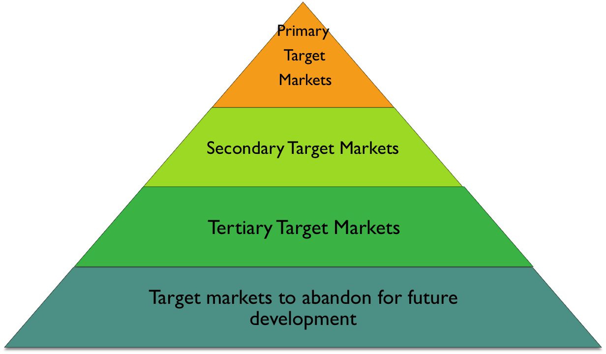
Target Marketing: Profiles
Develop profiles of each potential target market
Link to long alt text description
Notes:
Primary target markets—those segments that clearly have the best chance of meeting ROI goals and the other attractiveness factors.
Secondary target markets—those segments that have reasonable potential but for one reason or another are not best suited for development immediately.
Tertiary target markets—those segments that may develop emerging attractiveness for investment in the future but that do not appear attractive at present.
Target markets to abandon for future development.

Slide 20
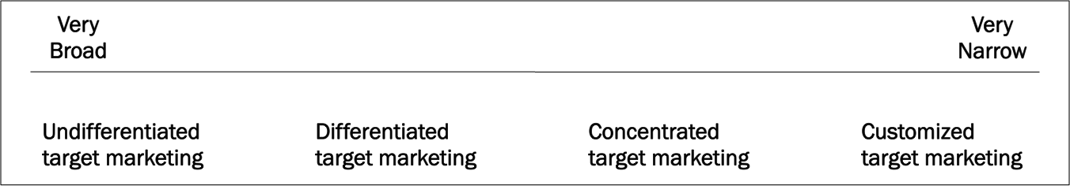
Continuum of Target Marketing Approaches
EXHIBIT 7.12
Link to long alt text description

Slide 21
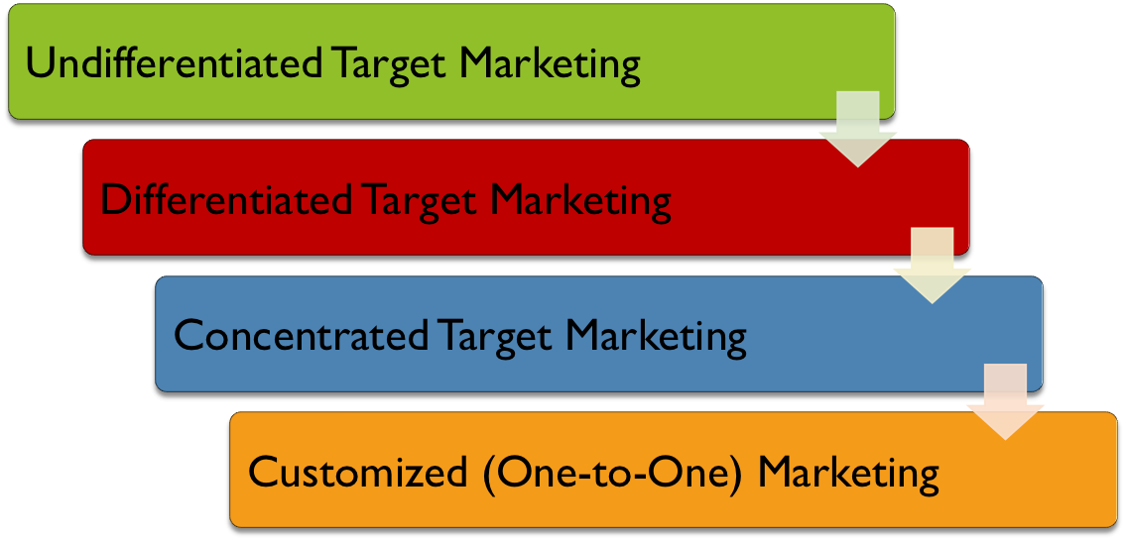
Target Marketing: Select an Approach
Select a target marketing approach.
Notes:
The broadest possible approach is undifferentiated target marketing—which is essentially a one-market strategy, sometimes referred to as an unsegmented mass market. Firms whose market approach is grounded in Porter’s competitive strategy of low cost may use a relatively undifferentiated target marketing strategy based primarily on the resulting price advantage.
Differentiated target marketing, often referred to as simply differentiation, which as you read earlier in this chapter, means developing different value offerings for different targeted segments. Possible sources of differentiation are many and include innovation/R&D, product quality, service leadership, employees, convenience, brand image, technology, corporate social responsibility, and many others.
Marketing A concentrated target marketing approach, which Michael Porter refers to as a focus strategy and is also popularly called a niche strategy, involves targeting a large portion of a small market.
With the proliferation of CRM, firms are able to develop more customized approaches to target marketing. In Chapter 1 we said that customized (one-to-one) marketing advocates that firms should direct energy and resources into establishing a learning relationship with each customer and then connect that knowledge with the firm’s production and service capabilities to fulfill that customer’s needs in as custom a manner as possible.

Slide 22
Positioning
The firm must turn its attention to creating, communicating, and delivering the value offering to the target markets……Positioning the product so that consumers understand its ability to fulfill their needs and wants.
Positioning is not what the company does to the product. It’s what the company does to the mind of the customer.
Notes:
The marketing mix of product, supply chain, price, and promotion is at the heart of positioning, and positioning strategies for a target market are executed through the development of unique combinations of these marketing mix variables. Positioning doesn’t occur in a vacuum; firms must position their offerings against competitors’ offerings.

Slide 23
Positioning and Research
Positioning studies often starts with focus groups that develop set of attributes.
Next, surveys are developed that have respondents rate the attributes of the firm and of its competitors.
Finally, gap analysis is used to determine gaps in what the company promises customers and what it actually delivers. Analysis identifies gaps by attribute in importance vs. delivery and vs. competitors.
Notes:
Many positioning studies start with focus groups that allow participants to talk about aspects of their experiences with a product. From the focus groups, a set of attributes is developed for further analysis. Attributes of a product represent salient issues that consumers consider when evaluating the product. Typically, after a series of focus groups to develop or confirm the relevant attributes, the positioning research moves to a survey methodology in which respondents rate the importance of each attribute, as well as the degree to which each of several competitors’ products exhibit the attributes of interest.
The results of such a survey can be analyzed through a gap analysis that shows not only gaps by attribute in importance versus delivery, but also gaps among the competitors in delivery.

Slide 24
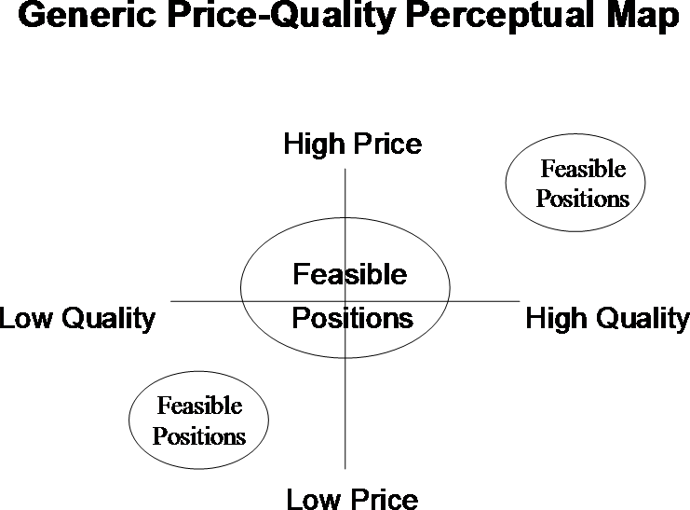
Examples of Perceptual Maps Used in Positioning Decisions
EXHIBIT 7.13a
Link to long alt text description

Slide 25
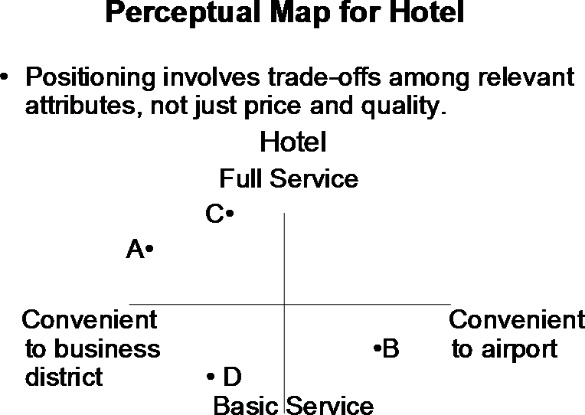
Examples of Perceptual Maps Used in Positioning Decisions (Hotel)
EXHIBIT 7.13b
Link to long alt text description

Slide 26
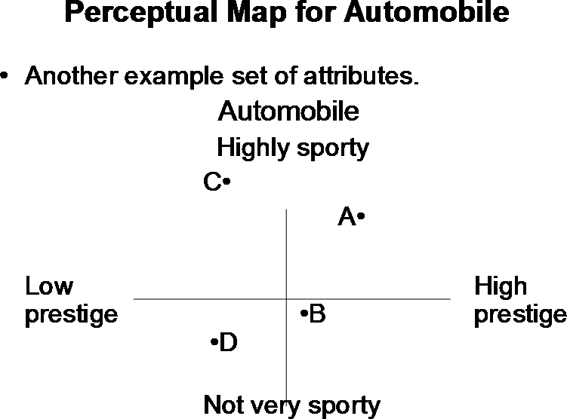
Examples of Perceptual Maps Used in Positioning Decisions
EXHIBIT 7.13c
Link to long alt text description

Slide 27
Sources of Differential Competitive Advantage
Company | Advantage
Walmart | Price leadership
Apple | Innovative leadership
Ritz-Carlton | Service leadership
BMW | Product leadership
Southwest Airlines | Personnel leadership
Amazon | Convenience leadership
Harley-Davidson | Image leadership
Notes:
Price leadership: Efficiencies in cost of labor, materials, supply chain, or other operational elements enabling the price leader to charge less. Example: Walmart.
Innovative leadership: constantly developing the “next new thing.” Example: Apple.
Service leadership: having an unusual and notable commitment to providing service to customers. Example: Ritz-Carlton.
Product leadership: performance, features, durability, reliability, style, and so on. Example: BMW.
Personnel leadership: hiring employees who are competent, reliable, courteous, credible, responsive, and able to communicate clearly. Examples: Chick-fil-A, Southwest Airlines.
Convenience leadership: making the product or service significantly easier to obtain. Example: Amazon.com.
Image leadership: symbols, atmosphere, and creative media. Example: Harley-Davidson.

Slide 28
Positioning Errors
Company | Error
Audi | Underpositioning
Dell, Tiffany’s | Overpositioning
McDonald’s | Confused positioning
AIG | Doubtful positioning
Notes:
Underpositioning: when consumers have only a vague idea about the company and its products, and do not perceive any real differentiation.
Overpositioning: when consumers have too narrow an understanding of the company, product, or brand.
Confused positioning: when frequent changes and contradictory messages confuse consumers regarding the positioning of the brand.
Doubtful positioning: when the claims made for the product or brand are not regarded as credible by consumers.

Slide 29
Alt Text Appendix
All long alt text descriptions are included in this appendix.

Slide 30
Market Segmentation, Target Marketing, and Positioning
Market segmentation appears at the top of the flow chart. Market segmentation is dividing a market into meaningful smaller markets or submarkets based on common characteristics. An arrow points to target marketing. Target marketing is evaluating the market segments, then making decisions about which among them is most worthy of investment for development. An arrow from there points to positioning. Positioning is communicating one or more sources of value to customers in ways that connect needs and wants to what the product has to offer. Positioning strategies are executed through the development of unique combinations of the marketing mix variables.

Slide 31
Geographic Segmentation
Geographic segmentation is in a circle at the center of the image. This is surrounded by five categories. They are by region, by density of population, by size of population, by growth of population, and by climate.

Slide 32
Demographic Segmentation
The categories of demographic segmentation are: age, generational group, gender, family and household, race and ethnicity, income, occupation, education, social class, and geodemographics.

Slide 33
VALS Framework
The top of the VALS Framework is identified by high resources and high innovation, while the bottom is identified by low resources and low innovation. At the top of the framework are the innovators. At the bottom of the framework are the survivors. Between the innovators and survivors, there are three categories of people grouped by their primary motivation. On the leftmost category are people motivated by ideals. The thinkers are at the top, closer to the innovators. The believers at at the bottom, closer to the survivors. In the middle category are the people whose primary motivation is achievement. In this category, the achievers are on top and the strivers are on the bottom. In the rightmost category are those motivated by self-expression. At the top of this group are the experiencers and at the bottom are the makers.

Slide 34
Target Marketing: Market Segment Analysis
The factors used to analyze market segments are shown in a pyramid. At the base is the strategic fit of the segment. In the middle are the competitive forces related to the segment. At the top are the segment size and growth potential.

Slide 35
Target Marketing: Profiles
There are four types of target-market profiles, which are displayed in a pyramid. At the top are the primary target markets. Just beneath them are the secondary target markets. Next are the tertiary target markets. Finally, at the bottom of the pyramid, are the target markets to abandon for future development.

Slide 36
Continuum of Target Marketing Approaches
The continuum of target marketing runs from very broad to very narrow. At the broadest end, on the left, is undifferentiated target marketing. Moving to the right, we reach differentiated target marketing. Then, we find concentrated target marketing. Finally, at the narrowest end of the continuum, on the far right side, is customized target marketing.

Slide 37
Examples of Perceptual Maps Used in Positioning Decisions
The generic price-quality perceptual map shows quality on the x-axis and price on the y-axis. Quality increases moving to the right. Price increases moving up. In the center is a large oval representing feasible positions. This oval takes up equal area in all four quadrants. The lower-left quadrant, which represents low quality and low price, has a smaller oval marked feasible positions. Another smaller feasible-positions oval appears in the upper-right quadrant, which represents high quality and high price.

Slide 38
Examples of Perceptual Maps Used in Positioning Decisions (Hotel)
Positioning involves trade-offs among relevant attributes, not just price and quality. In this map for a hotel, convenient location is on the x-axis. At the far left end is convenience to the business district. At the far right end is convenience to the airport. The service level of the hotel is shown on the y-axis. At the bottom, is basic service and at the top is full service. In the upper-left quadrant, are two points, A and C. Based on their quadrant, we can tell that points A and C represent relatively high levels of service and convenience to the business district. Hotel A is further to the left, but slightly lower. This tells us it has a more convenient business-district location, but slightly less service than Hotel C, which offers the fullest level of service. In the lower-left quadrant is Hotel D. We can see that point D is more convenient to the business district than to the airport. It also offers the most basic service. Finally, Hotel B is in the lower-right quadrant. This shows us that it is most convenient to the airport and offers relatively basic service.

Slide 39
Examples of Perceptual Maps Used in Positioning Decisions (Automobile)
Automobiles present another example of attributes, specifically sportiness and prestige. The x-axis depicts prestige, with low prestige on the left and high prestige on the right. The y-axis presents sportiness, with the bottom described as being "not very sporty" and the top being "highly sporty." This creates four quadrants. In the upper-left, point C depicts an automobile that is the mostly sporty, but relatively low in prestige. In the upper-right quadrant, point A depicts a car that is also quite sporty, and also high prestige. The lower-right quadrant contains point B, which is very close to the point where the two axes intersect. It is a little prestigious and slightly less sporty than average. Finally, in the lower-left quadrant, is point D. This automobile is relatively low in both prestige and sportiness.

